Slide 1
EMBT-ESE 4009
INTERFACING GPS MODULE WITH ESP32
Project topic:Health monitoring device using IOT -connected headphone.
Group Number : 2
Group Members:
Christy Rachel Philip
Fahad Rahman
James M. Chacko
Premil Prasannan
Instructor : Mike Aleshams
Presented by,
Christy Rachel Philip

Slide 2
Contents
Introduction.
An Overview of the Project.
Engineering Drawing
Block Diagram
Hardware Overview of NEO-6M GPS Module
NEO-6M GPS Module Pinout
Protocols and Interfaces
Interfacing GPS Module with ESP32 using MQTT Protocol
Conclusion.
References.

Slide 3
Introduction
This presentation includes the details regarding one of the basic task of our project, which is the Interfacing of NEO-6M GPS Module with ESP32 Microcontroller Board. As a part of that, we will explain major details of the NEO-6M GPS Module as well.

Slide 4
An Overview of the Project.
The topic of our project is “Health monitoring device using IOT-connected headphone.”
Our Project is an IoT-connected health care device, which is connected as a part of Bluetooth headphones. It consists of EKG sensor, pulse oximeter, temperature sensor, GPS and GSM to obtain various health-related data such as blood oxygen level, temperature, EKG and patients live location.
The device can be connected to a mobile phone through IoT. The user's information such as height, weight and previous history can add in the webserver earlier itself. Using this, the family doctor can access it directly and monitor the patient's condition every day and communicate with them. Along with this, it has a push-button as well, so in case of emergencies, patient’s can press it by themselves and send information to 911 and doctor.

Slide 5
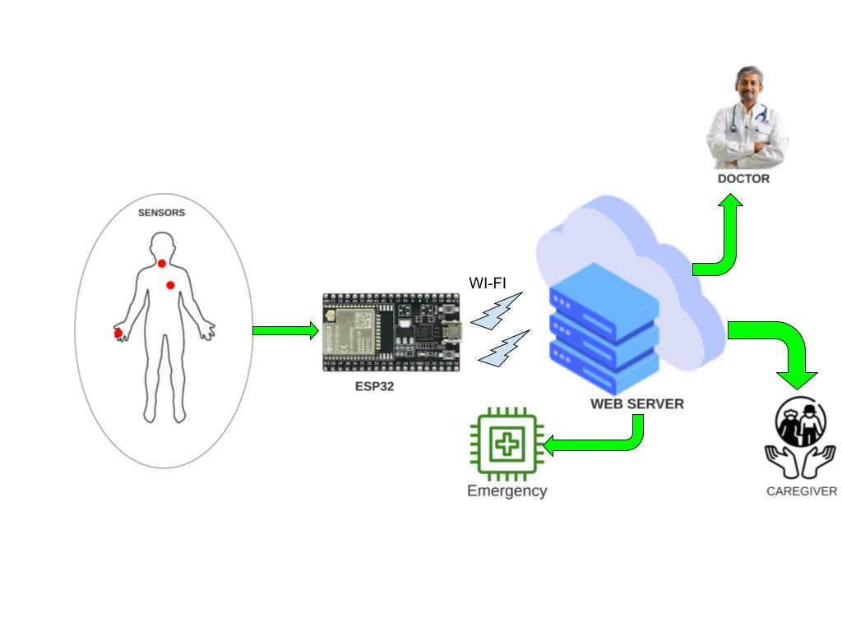
Engineering Drawing

Slide 6
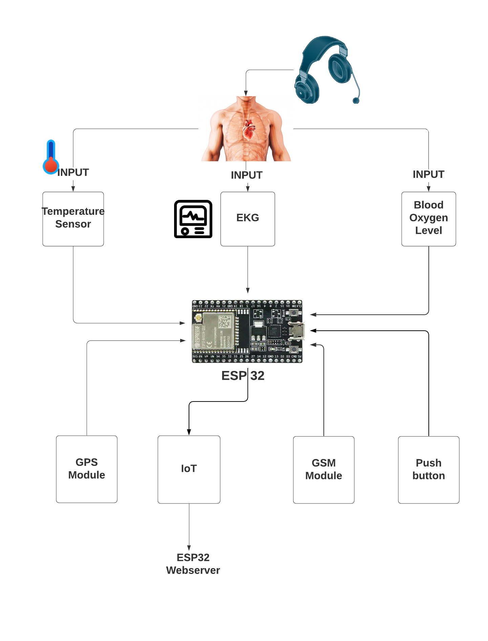
Block Diagram

Slide 7
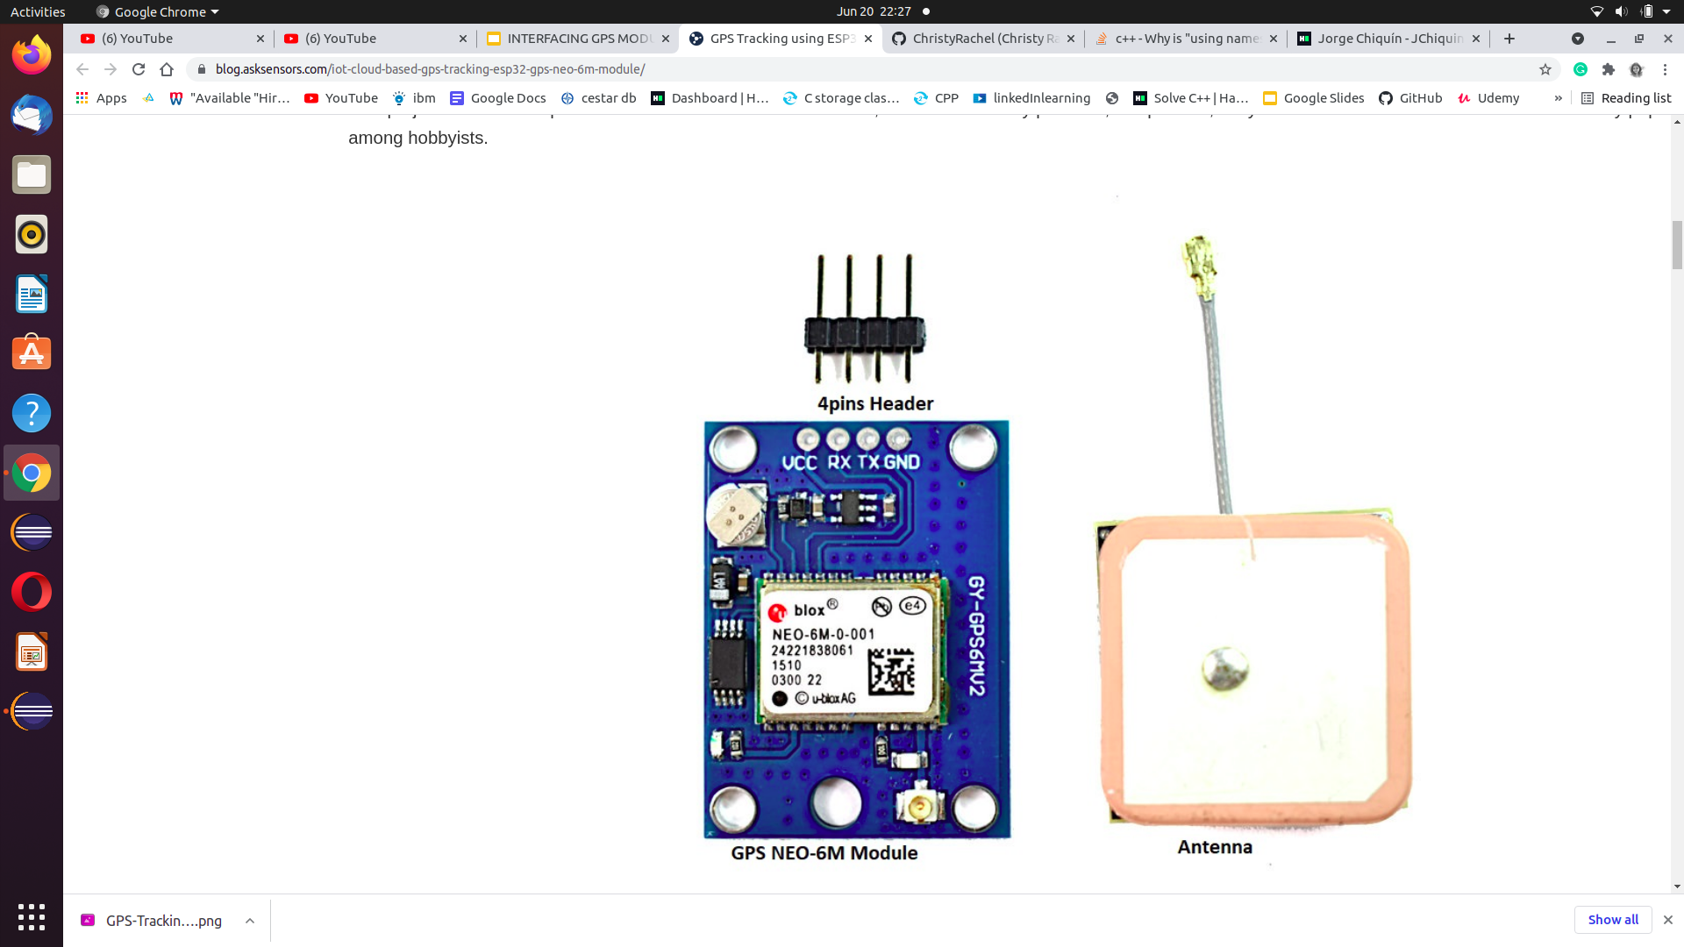
NEO-6M GPS Module.

Slide 8
NEO-6M GPS Module.
￼
￼
￼
This module is a NEO-6M GPS chip from u-blox. It can track up to 22 satellites on 50 channels and achieves the industry’s highest level of sensitivity i.e. -161 dB tracking, while consuming only 45mA supply current.
Unlike other GPS modules, it can do up to 5 location updates a second with 2.5m Horizontal position accuracy. The u-blox 6 positioning engine also boasts a Time-To-First-Fix (TTFF) of under 1 second.
One of the best features the chip provides is Power Save Mode(PSM). It allows a reduction in system power consumption by selectively switching parts of the receiver ON and OFF. This dramatically reduces power consumption of the module to just 11mA making it suitable for power sensitive applications like GPS wristwatch.

Slide 9
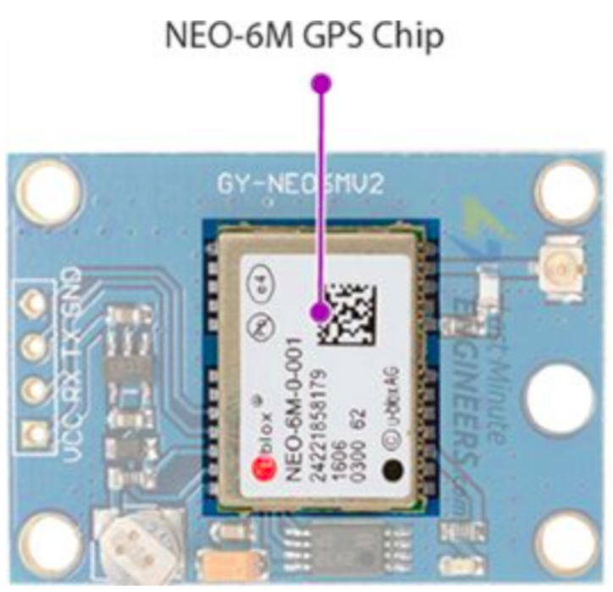
Hardware Overview of NEO-6M GPS Module
NEO-6M GPS Chip
At the heart of the module is a NEO-6M GPS chip from u-blox. The chip measures less than the size of a postage stamp but packs a surprising amount of features into its little frame.
It can track up to 22 satellites on 50 channels and achieves the industry’s highest level of sensitivity i.e. -161 dB tracking, while consuming only 45mA supply current. Unlike other GPS modules, it can do up to 5 location updates a second with 2.5m Horizontal position accuracy.

Slide 10
NEO-6M GPS Chip
The u-blox 6 positioning engine also boasts a Time-To-First-Fix (TTFF) of under 1 second.
One of the best features the chip provides is Power Save Mode(PSM). It allows a reduction in system power consumption by selectively switching parts of the receiver ON and OFF. This dramatically reduces power consumption of the module to just 11mA making it suitable for power sensitive applications like GPS wristwatch.
The necessary data pins of NEO-6M GPS chip are broken out to a 0.1″ pitch headers. This includes pins required for communication with a microcontroller over UART. The module supports baud rate from 4800bps to 230400 bps with default baud of 9600.

Slide 11
Specifications
Power supply: 2.7V to 3.6V
Default baud rate: 9600 bps
Current consumption: 45mA.
Up to 22 satellites on 50 channels tracking
Up to 5 location updates a second with 2.5m Horizontal position accuracy.
Navigation Sensitivity: Up to -161 dBm
Navigation Update Rate: 1Hz
Comes with an external antenna and built-in EEPROM.
Interface: RS232 TTL with Serial Baud Rate 4800-230400 (default 9600)
Operating Temperature: -40°C ~ 85°C
Communication Protocol: UBX Binary, RTCM and Standard NMEA output

Slide 12
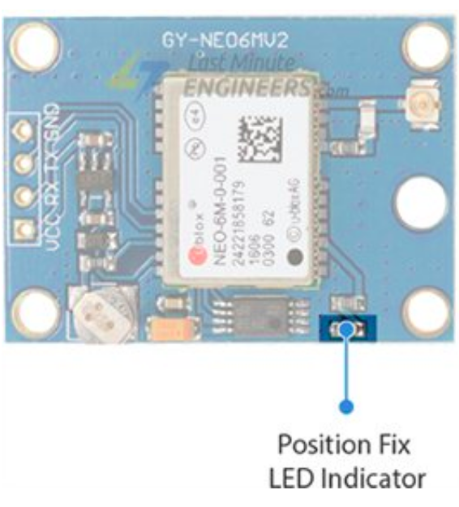
Position Fix LED Indicator
There is an LED on the NEO-6M GPS Module which indicates the status of Position Fix. It’ll blink at various rates depending on what state it’s in:
No Blinking – It’s searching for satellites.
Blink every 1s – Position Fix is found(The module can see enough satellites).

Slide 13
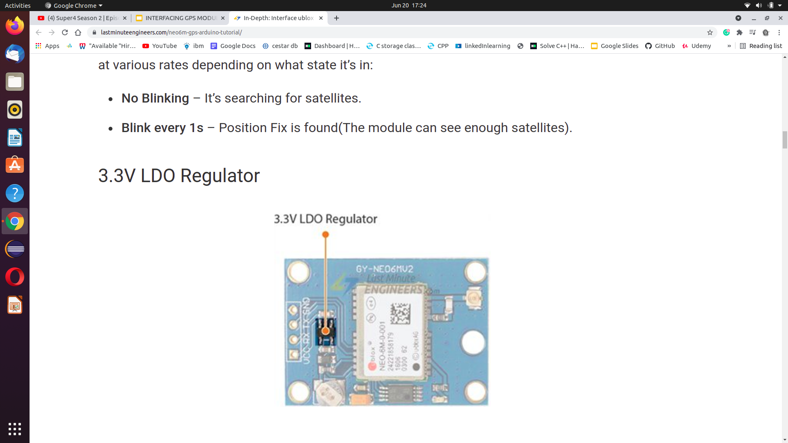
3.3V LDO Regulator
The operating voltage of the NEO-6M chip is from 2.7 to 3.6V. But the good news is that, the module comes with MIC5205 ultra-low dropout 3V3 regulator from MICREL.
The logic pins are also 5-volt tolerant, so we can easily connect it to an Arduino or any 5V logic microcontroller without using any logic level converter.

Slide 14
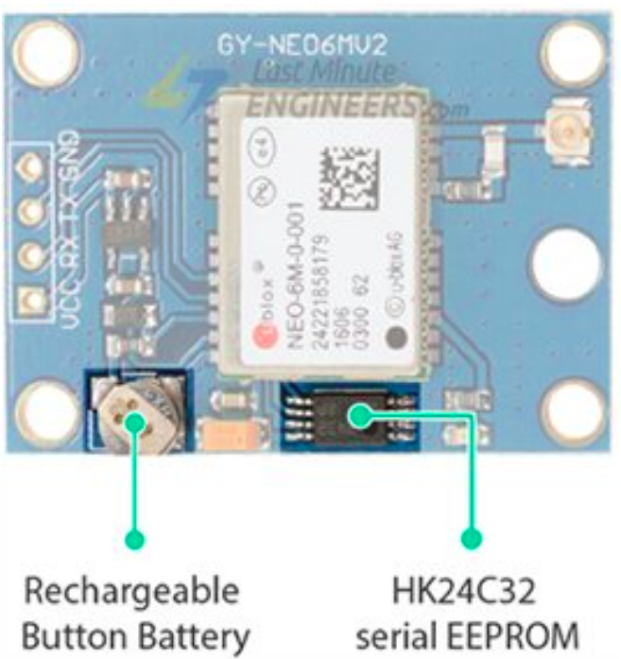
Battery and EEPROM
The module is equipped with an HK24C32 two wire serial EEPROM. It is 4KB in size and connected to the NEO-6M chip via I2C.
The module also contains a rechargeable button battery which acts as a super-capacitor.

Slide 15
Battery and EEPROM
An EEPROM together with battery helps retain the battery backed RAM (BBR). The BBR contains clock data, latest position data(GNSS orbit data) and module configuration. But it’s not meant for permanent data storage.
As the battery retains clock and last position, time to first fix (TTFF) significantly reduces to 1s. This allows much faster position locks.
Without the battery the GPS always cold-start so the initial GPS lock takes more time.
The battery is automatically charged when power is applied and maintains data for up to two weeks without power.

Slide 16
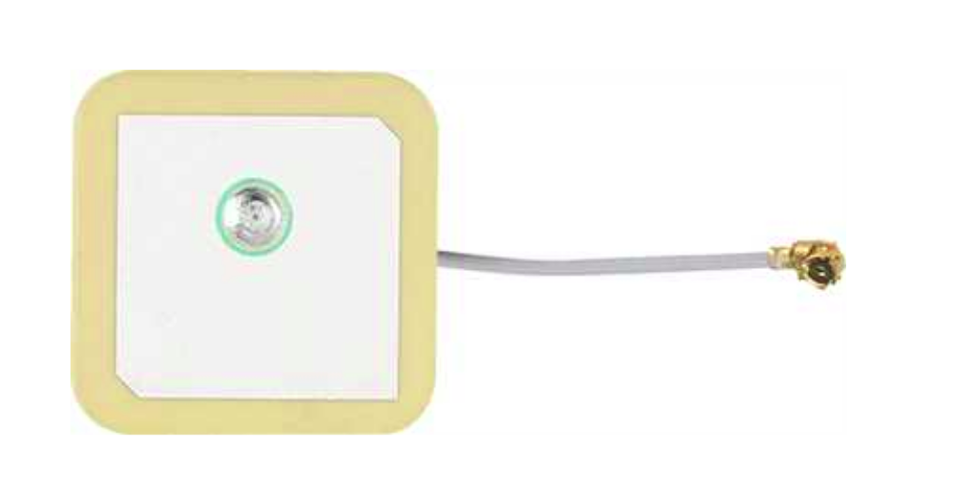
Antenna
An antenna is required to use the module for any kind of communication. So, the module comes with a patch antenna having -161 dBm sensitivity.
NEO-6M Patch Antenna
You can snap-fit this antenna to small U.FL connector located on the module.

Slide 17
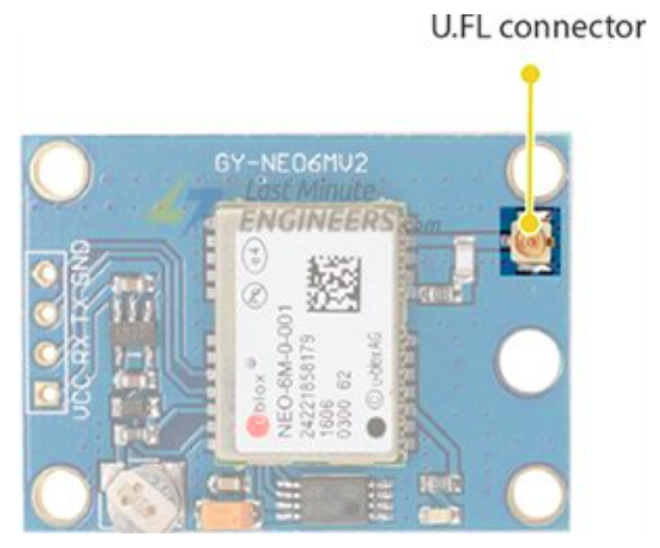
Antenna
Patch antenna is great for most projects. But if you want to achieve more sensitivity or put your module inside a metal case, you can also snap on any 3V active GPS antenna via the U.FL connector.

Slide 18
NEO-6M GPS Module Pinout
The NEO-6M GPS module has total 4 pins that interface it to the outside world. The connections are as follows:
GND is the Ground Pin and needs to be connected to GND pin on the Arduino.
TxD (Transmitter) pin is used for serial communication.
RxD (Receiver) pin is used for serial communication.
VCC VCC supplies power for the module. You can directly connect it to the 5V pin on the Arduino.
Pinout diagram is in the following slide.

Slide 19
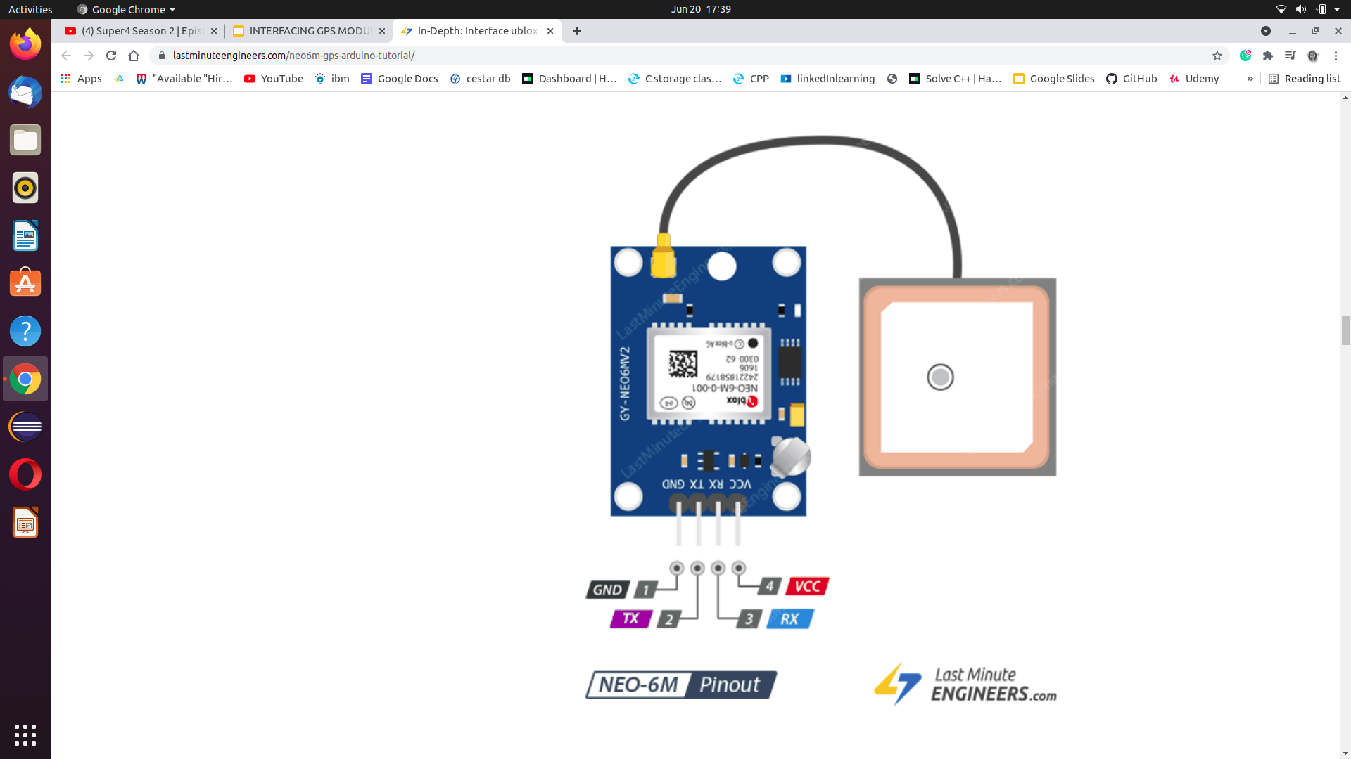
PINOUT Diagram

Slide 20
Protocols and interfaces
UART
NEO-6 modules include one configurable UART interface for serial communication.
USB
NEO-6 modules provide a USB version 2.0 FS (Full Speed, 12 Mbit/s) interface as an alternative to the UART. The pull-up resistor on USB_DP is integrated to signal a full-speed device to the host. The VDDUSB pin supplies the
USB interface. u-blox provides a Microsoft® certified USB driver for Windows XP, Windows Vista and Windows 7 operating systems.

Slide 21
Protocols and interfaces
3. Serial Peripheral Interface (SPI)
The SPI interface allows for the connection of external devices with a serial interface, e.g. serial flash to save configuration and AssistNow Offline A-GPS data or to interface to a host CPU. The interface can be operated in master or slave mode. In master mode, one chip select signal is available to select external slaves. In slave mode a single chip select signal enables communication with the host.
The maximum bandwidth is 100kbit/s.

Slide 22
Protocols and interfaces
4. Display Data Channel (DDC)
The I2C compatible DDC interface can be used either to access external devices with a serial interface EEPROM or to interface with a host CPU. It is capable of master and slave operation. The DDC interface is I2C Standard Mode
compliant. For timing parameters consult the I2C standard.
The DDC Interface supports serial communication with u-blox wireless modules. See the specification of the applicable wireless module to confirm compatibility.
The maximum bandwidth is 100kbit/s.

Slide 23
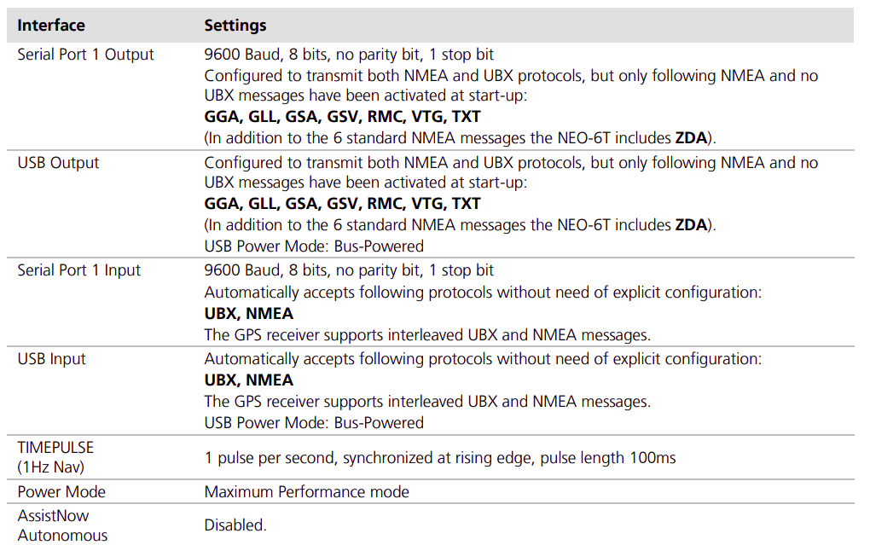
Default settings

Slide 24
Interfacing GPS Module with ESP32 using MQTT Protocol
Requirements
NEO-6M GPS module
ESP32 development board.
Breadboard
Jumper wires
Computer running Arduino IDE software.
USB micro cable to connect ESP32 development board to the computer.
A WiFi Hotspot

Slide 25
Interfacing GPS Module with ESP32 using MQTT Protocol
Connections
The GPS module will be powered with 3.3V power supply. It communicates with the ESP32 via serial communication using the TX and RX pins available on the 4 pins header.
Connect the VCC pin of the GPS module to the ESP32 3.3V pin.
Connect the GPS ground pin to the ESP32 ground pin.
Now, connect the RX pin of the GPS module to the TX pin of the ESP32. Similarly, connect the TX pin of the GPS module to the RX pin of the ESP32 (RX and TX pins of the ESP32 are defined in the software).
Last, connect your ESP32 to the computer through a USB cable. The ESP32 will be powered from the USB 5V.

Slide 26
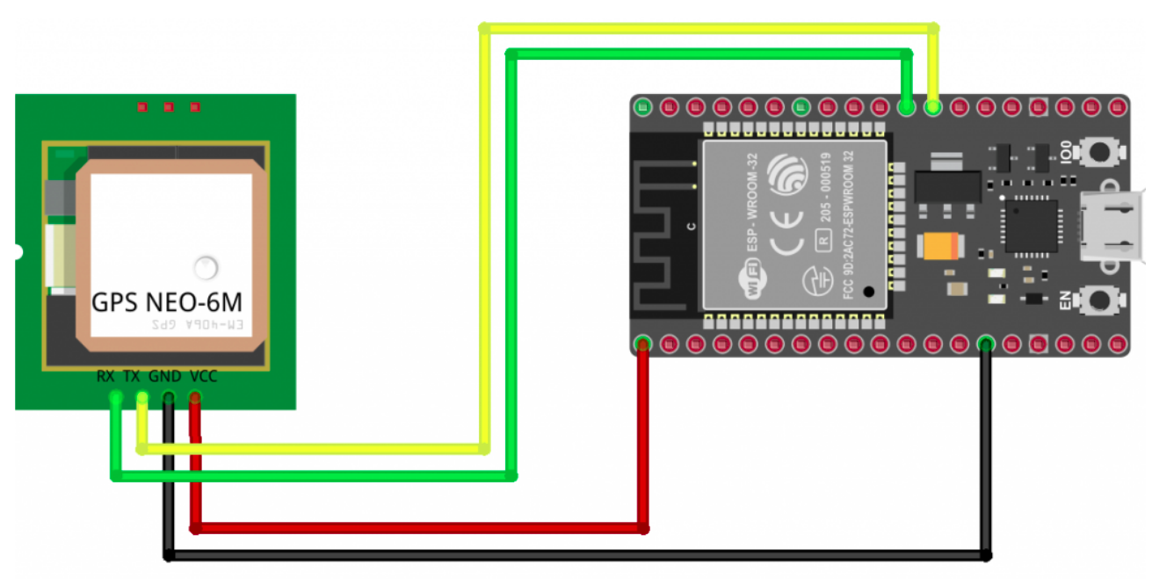
Circuit Diagram

Slide 27
Install the ESP32 in Arduino IDE
The ESP32 will be programmed using Arduino IDE. There’s an add-on for the Arduino IDE (1.8.7 or higher) that allows you to program the ESP32 using the Arduino IDE and its programming language. Follow the instructions below:
Open the preferences window from the Arduino IDE : File> Preferences.
Go to the “Additional Board Manager URLs” field, Enter the following URL: https://dl.espressif.com/dl/package_esp32_index.json
Open boards manager (Tools > Board > Boards Manager), search for ESP32 and click the install button for the “ESP32 by Espressif Systems”.

Slide 28
Interfacing GPS Module with ESP32 using MQTT Protocol
When we run the code, connect the ESP32 board to our computer through the micro-USB cable. Make sure the power LED goes high on the module to ensure power supply.
Open your Arduino IDE and select Tools options for the ESP32 board type and serial port where it’s connected then click upload. The code will be running automatically after Reset.
Open the serial terminal to supervise the ESP32 software sequence step by step.
Now, we will return back to the monitor the GPS Tracker map updated by the ESP32 development board based on data parsed from GPS NEO-M6 Module.

Slide 29
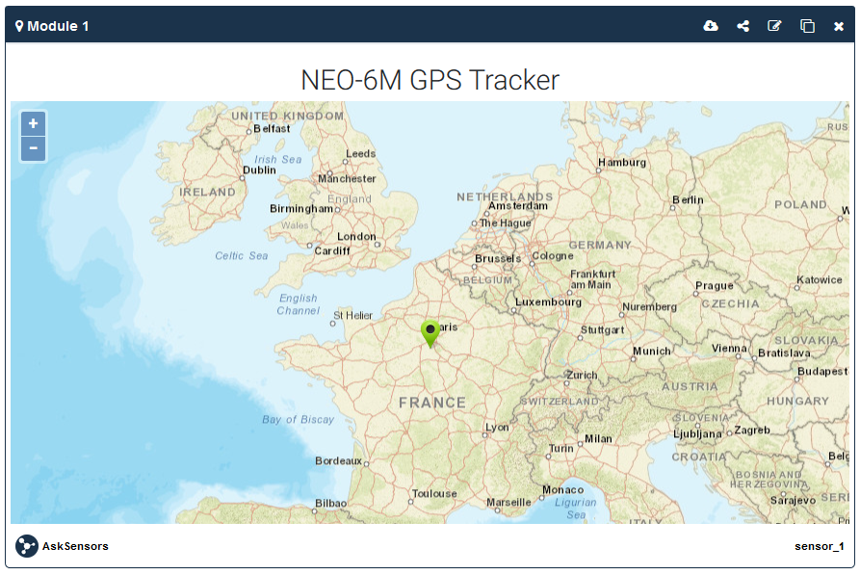
Sample Output

Slide 30
Source Code
/*
* MQTT and AskSensors IoT Platform
* Description: ESP32 publishes NEO-6M GPS position to AskSensors using MQTT
* Author: https://asksensors.com, 2020
* github: https://github.com/asksensors
*/
#include <WiFi.h>
#include <PubSubClient.h>
#include <SoftwareSerial.h>
#include <TinyGPS++.h>
//TODO: ESP32 MQTT user config
const char* ssid = ".................."; // Wifi SSID
const char* password = ".................."; // Wifi Password
const char* username = "................."; // my AskSensors username
const char* pubTopic = "publish/..../....."; // publish/username/apiKeyIn
const unsigned int writeInterval = 25000; // write interval (in ms)

Slide 31
Source Code
static const int RXPin = 16, TXPin = 17;
static const uint32_t GPSBaud = 9600;
//AskSensors MQTT config
const char* mqtt_server = "mqtt.asksensors.com";
unsigned int mqtt_port = 1883;
// objects
WiFiClient askClient;
PubSubClient client(askClient);
TinyGPSPlus gps; // The TinyGPS++ object
SoftwareSerial ss(RXPin, TXPin); // The serial connection to the GPS device
// setup
void setup() {
Serial.begin(115200);
Serial.println("*****************************************************");
Serial.println("********** Program Start : ESP32 publishes NEO-6M GPS position to AskSensors over MQTT");
Serial.print("********** connecting to WIFI : ");
Serial.println(ssid);

Slide 32
Source Code
WiFi.begin(ssid, password);
while (WiFi.status() != WL_CONNECTED) {
delay(500);
Serial.print(".");
}
Serial.println("");
Serial.println("->WiFi connected");
Serial.println("->IP address: ");
Serial.println(WiFi.localIP());
client.setServer(mqtt_server, mqtt_port);
client.setCallback(callback);
// GPS baud rate
ss.begin(GPSBaud);
}

Slide 33
Source Code
// loop
void loop() {
if (!client.connected())
reconnect();
client.loop();
// This sketch displays information every time a new sentence is correctly encoded.
while (ss.available() > 0)
if (gps.encode(ss.read()))
displayInfo();
if (millis() > 5000 && gps.charsProcessed() < 10)
{
Serial.println(F("No GPS detected: check wiring."));
while(true);
}
}

Slide 34
Source Code
// GPS displayInfo
void displayInfo() {
if (gps.location.isValid()) {
double latitude = (gps.location.lat());
double longitude = (gps.location.lng());
Serial.println("********** Publish MQTT data to ASKSENSORS");
char mqtt_payload[50] = "";
snprintf (mqtt_payload, 50, "m1=%lf;%lf", latitude, longitude);
Serial.print("Publish message: ");
Serial.println(mqtt_payload);
client.publish(pubTopic, mqtt_payload);
Serial.println("> MQTT data published");
Serial.println("********** End ");
Serial.println("*****************************************************");

Slide 35
Source Code
delay(writeInterval);// delay
} else {
Serial.println(F("INVALID"));
}
}
//MQTT callback
void callback(char* topic, byte* payload, unsigned int length) {
Serial.print("Message arrived [");
Serial.print(topic);
Serial.print("] ");
for (int i = 0; i < length; i++) {
Serial.print((char)payload[i]);
}
Serial.println();
}

Slide 36
Source Code
//MQTT reconnect
void reconnect() {
// Loop until we're reconnected
while (!client.connected()) {
Serial.print("********** Attempting MQTT connection...");
// Attempt to connect
if (client.connect("ESP32Client", username, "")) {
Serial.println("-> MQTT client connected");
} else {
Serial.print("failed, rc=");
Serial.print(client.state());
Serial.println("-> try again in 5 seconds");
// Wait 5 seconds before retrying
delay(5000);
}
}
}

Slide 37
Conclusion
In this presentation we discussed the details regarding one of the basic task of our project, which is the Interfacing of NEO-6M GPS Module with ESP32 Microcontroller Board. As a part of that, we explained major details of the NEO-6M GPS Module as well.

Slide 38
References
Adafruit. (n.d.). Adafruit Ultimate GPS. https://learn.adafruit.com/adafruit-ultimate-gps?view=all#built-in-logging
UBlox. (n.d.). NEO-6 u-blox 6 GPS Modules, Data Sheet https://www.u-blox.com/sites/default/files/products/documents/NEO-6_DataSheet_(GPS.G6-HW-09005).pdf
Last minute Engineers. (n.d.). Interface ublox NEO-6M GPS Module with Arduino. https://lastminuteengineers.com/neo6m-gps-arduino-tutorial/
Github. (2020, April 14). Asksensors. https://github.com/asksensors/Connect-ESP32-GPS-MQTT
Guru. (2020, April). GPS Tracking using ESP32 and IoT Platform over MQTT, The Ask Sensors Blog. https://blog.asksensors.com/iot-cloud-based-gps-tracking-esp32-gps-neo-6m-module/

Slide 39
Thank you

